Slide 1
ONLINE BUS RESERVATION SYSTEM
LAKSHMIPRIYA R ROLL NO:18
PAVIZHAM ANTONY ROLL NO:22
SALU K L ROLL NO:24
SANDRA JOHN C ROLL NO:25

Slide 2
CONTENT
Introduction
Existing system
Proposed system
Modules
Existing system
Features
System Design :
- ER Diagram
- Use case Diagram
- Class Diagram
Conclusion
Reference

Slide 3
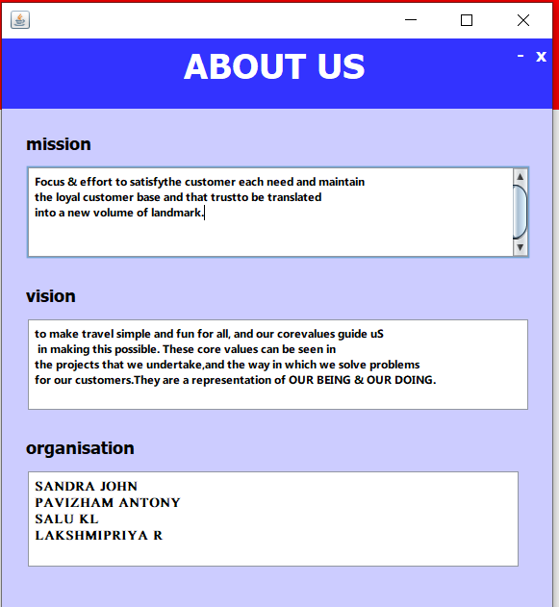
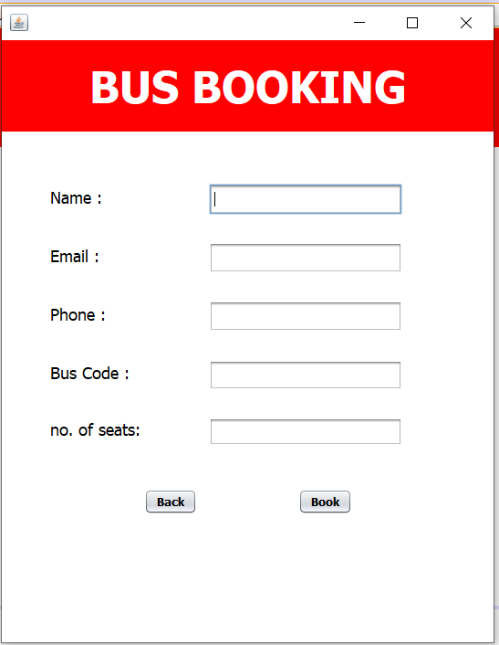
MODULES

Slide 4
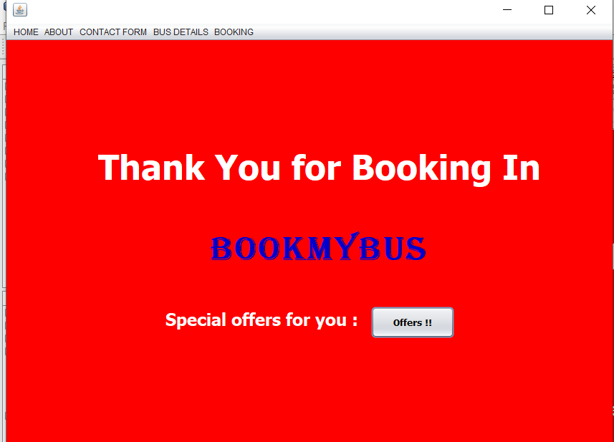
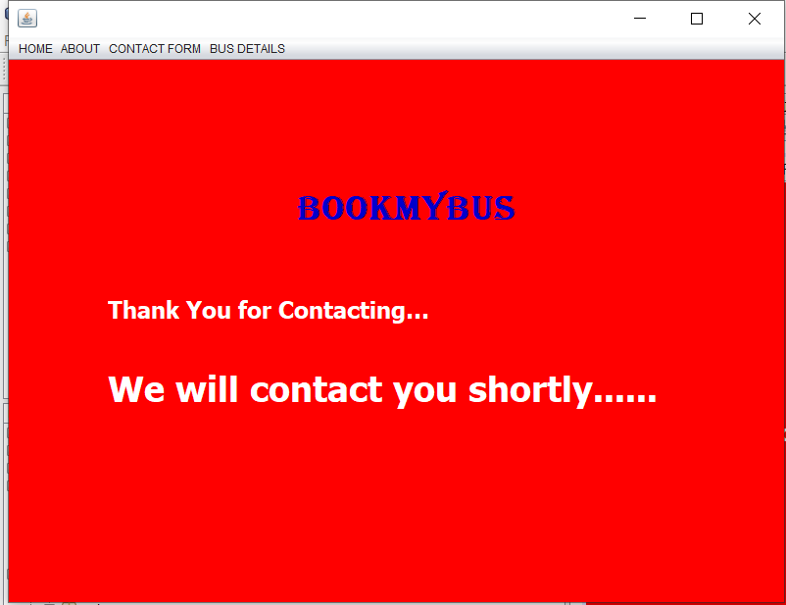

Slide 5
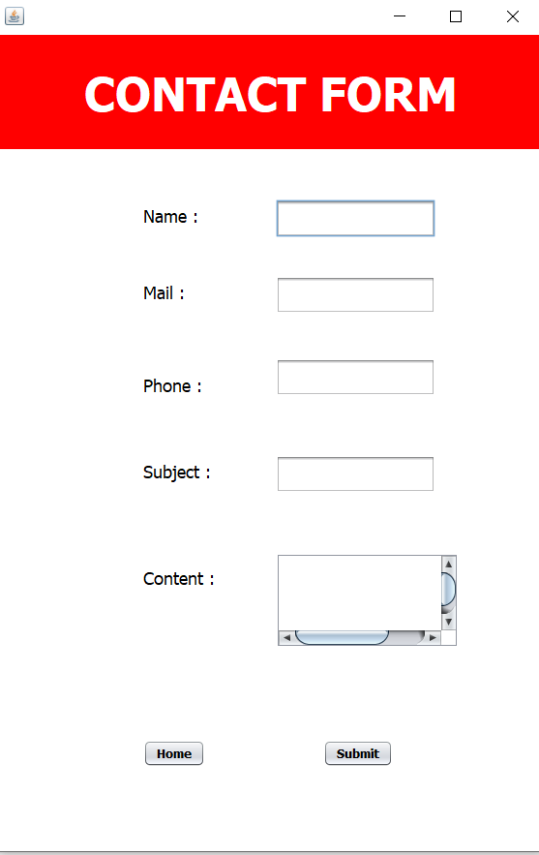
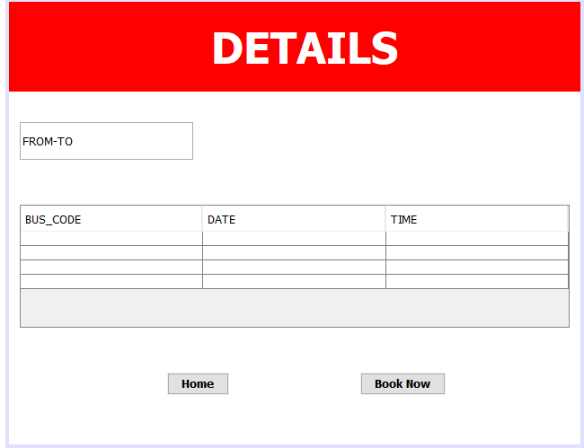

Slide 6
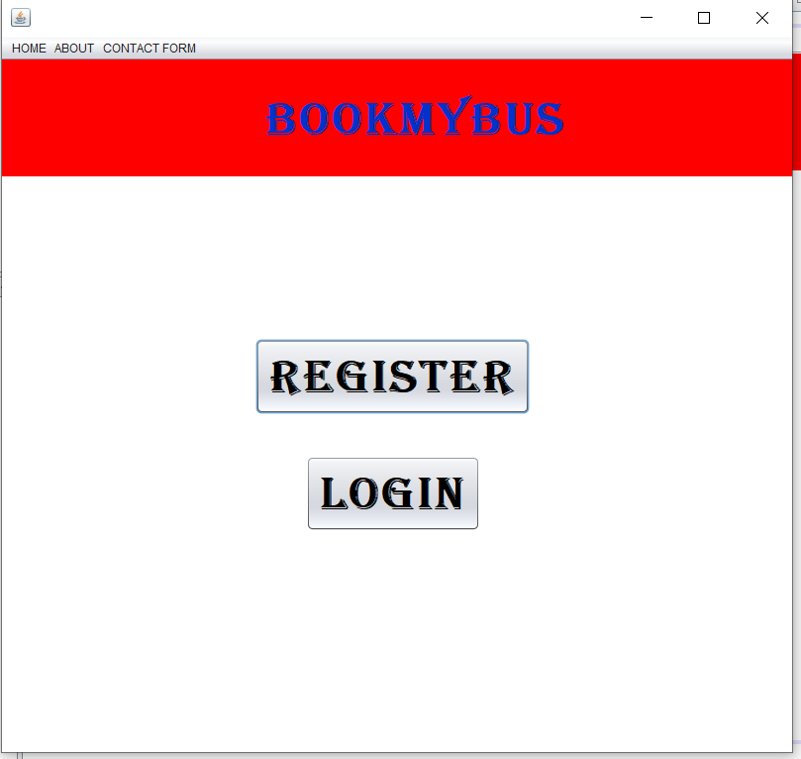
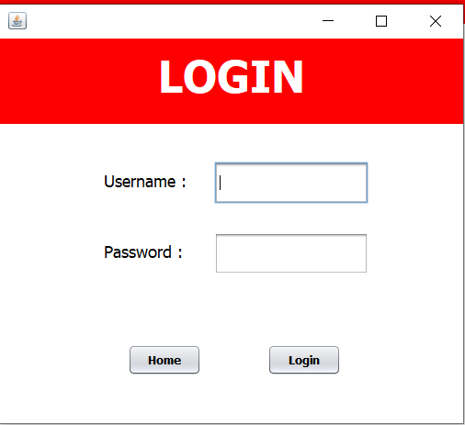
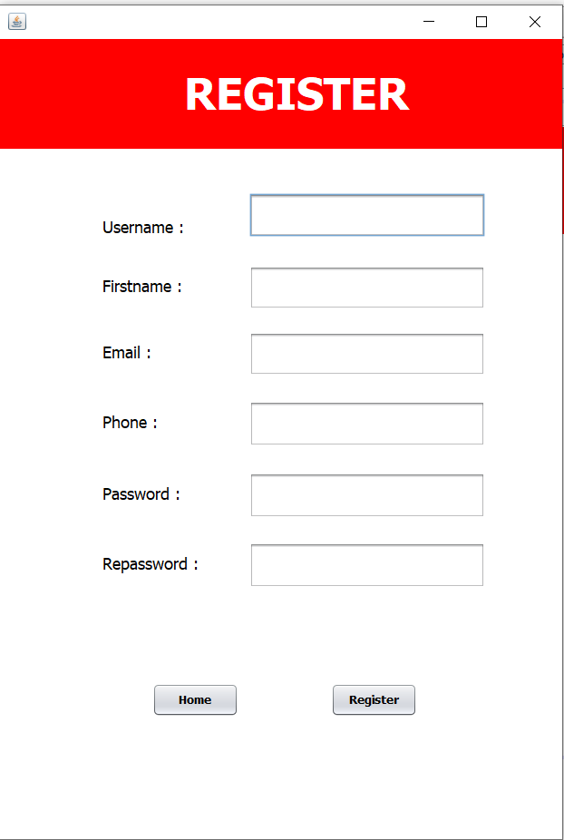
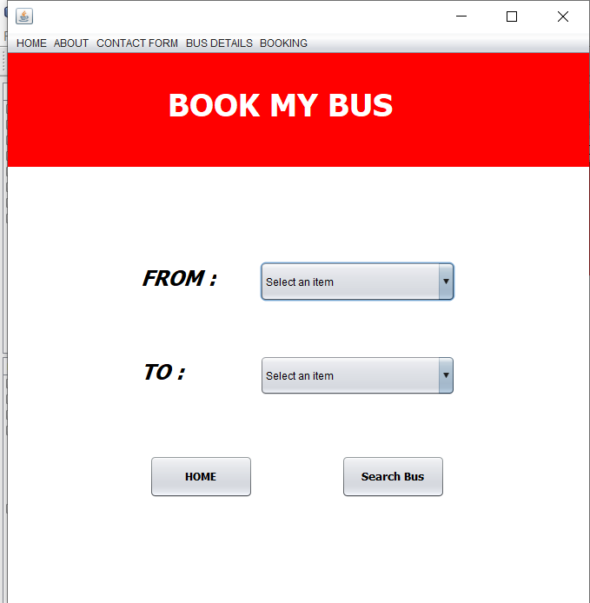

Slide 7
INTRODUCTION
Windows based application that works within centralised network.
Provides bus transportation system , facility to reserve seats and different types of enquiry which need an instant and quick reservation.
Built for manage and computerize the traditional database, ticket booking and travel made easy.
Maintains all data’s of users ,bus details , reservation details.

Slide 8
EXISTING SYSTEM
Internal system which used to sell tickets at the counter.
Customers need to pay cash when they buy the bus tickets .
Needs to queue up long time to get the tickets.

Slide 9
PROPOSED SYSTEM
Customers can buy the tickets over the internet,24 hours a day,7 days a week .
The bus tickets can’t be lost ,stolen or left behind.
Customers no need to pay cash to buy bus tickets because they can pay the bus ticket on the traveling time.
They can search the destinations and hence plan their journey.
Customers can make queries and feedback digitally and hence resolves their doubts.

Slide 10
ADVANTAGES
Online booking systems saves your time.
Highly convenient.
No need to stand in a long queue at bus stations.
Available 24/7.

Slide 11
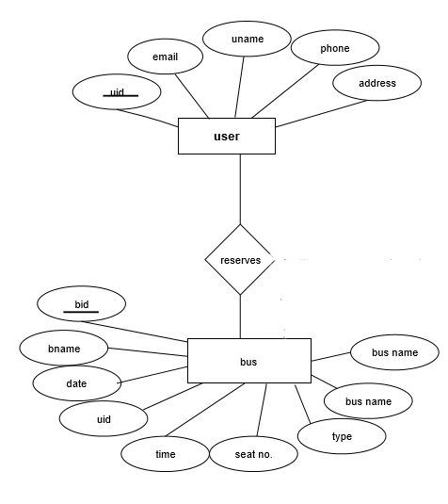
ER DIAGRAM

Slide 12
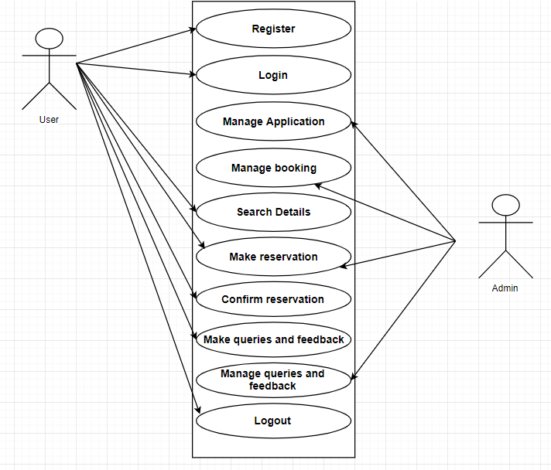
USE CASE DIAGRAM

Slide 13
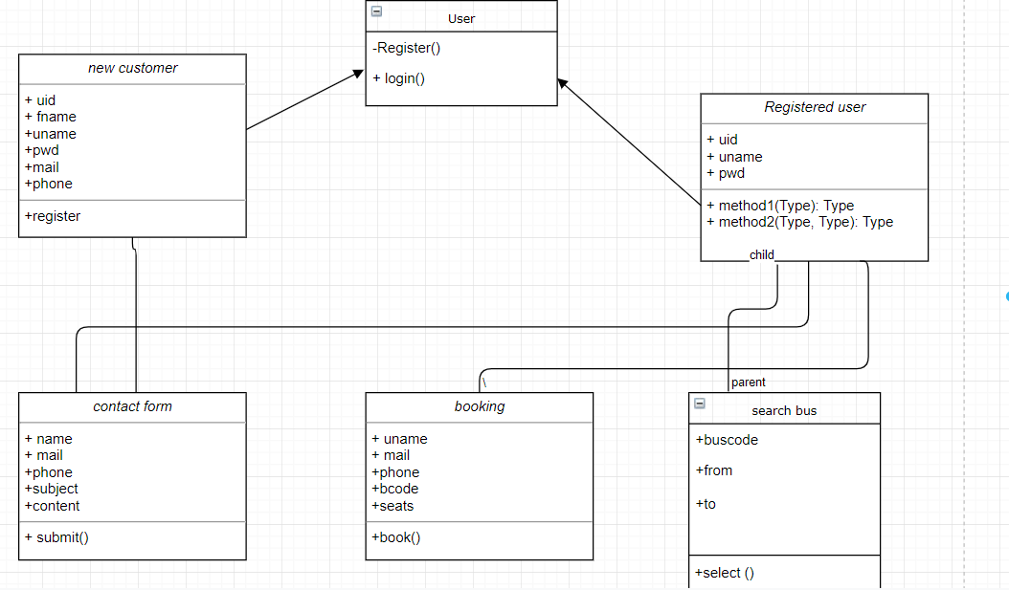
UML CLASS DIAGRAM

Slide 14
Conclusion
It can be observed that computer applications are very important in every field of hu-
man endeavor.
Here all the information about customer that made reservation can be gotten just by clicking a button with this new system, some of the difficulties encountered with the manual system are overcome.
It will also reduce the workload of the staff, reduce the time used for making reservation at the bus terminal and also increase efficiency. The application also has the ability to update records in various files automatically thereby relieving the company’s staff the stress of working from file security of data.
This project, as a whole, will give a new way in bus reservations and ticketing processes. The automation and management of seats and reservations will be done online. However , this project does not limit the walk-in passengers that is passengers who visit the company’s counter because it also caters for them. This also lessens the use of papers like in the traditional way of ticketing

Slide 15
REFERENCES
https://1000projects.org[2] "https://google.com"[3]
https://www.clock-software.com/blog/Benefits-of-online-booking-systems.html[4]
https://www.researchgate.net/publication/326468848OnlineBusTicketReservationSystemhttps://creately.com/diagram/example/hw99r5oi/ER

